Slide 1
Lovewatch 1702
ELEC 327
Yoseph Maguire, Yovahn Hoole, Chandler Burke

Slide 2
What is it?
Pulse Oximeter
Measures Heart Rate
If Heart Rate is above threshold, classifies the user as ‘In Love’
Very imprecise

Slide 3
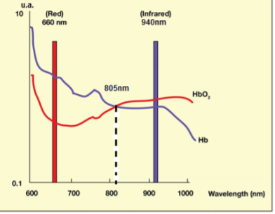
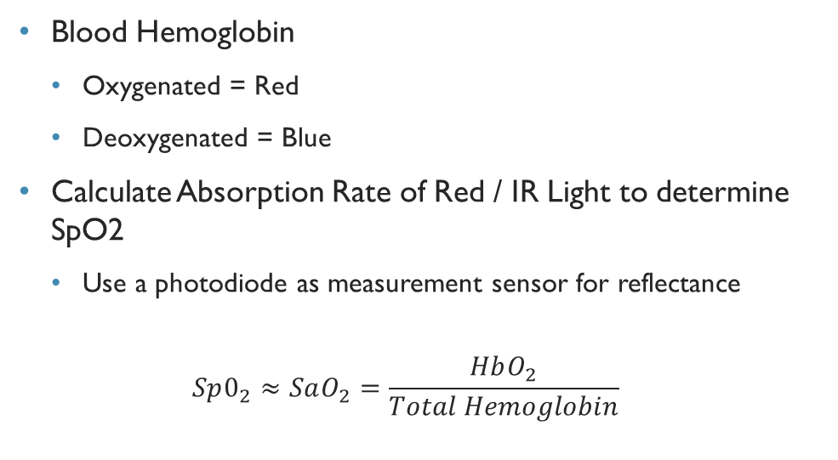
Pulse Oximetry
Blood Hemoglobin
Oxygenated = Red
Deoxygenated = Blue
Calculate Absorption Rate of Red / IR Light to determine SpO2
Use a photodiode as measurement sensor for reflectance
$$Sp0_{2}≈SaO_{2}=\frac{HbO_{2}}{Total Hemoglobin}$$

Slide 4
Heart Rate Measurement
Uses the same hardware features
Only needs IR colored light to determine volume of blood in tissue
Measures differences in recorded light by photodiode to determine HR (Heart Rate)
Most pulse-oxs measure absorbance at two wavelengths, we will only use IR.

Slide 5
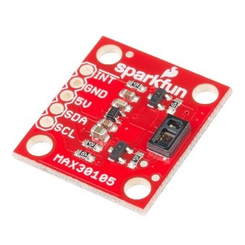
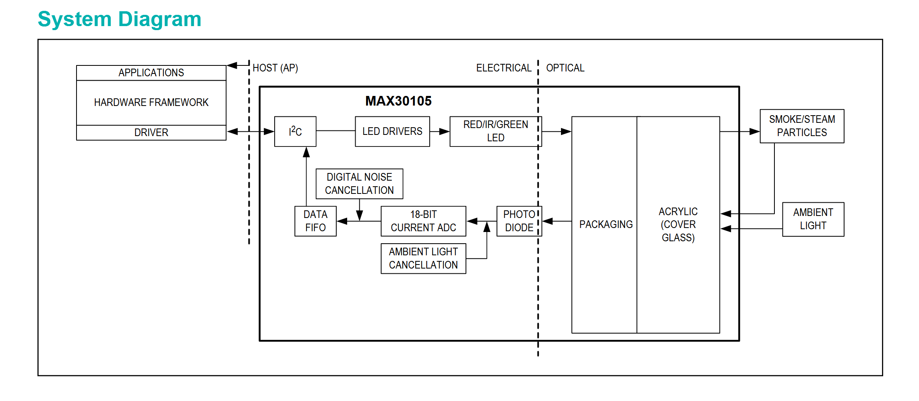
MAx30105 Particle Sensor
3 LEDs
Red, Green, IR
Red and IR necessary for Pulse Oximetry
Photodiode
Records Reflected Light
I2C Communication
Requires pullups

Slide 6
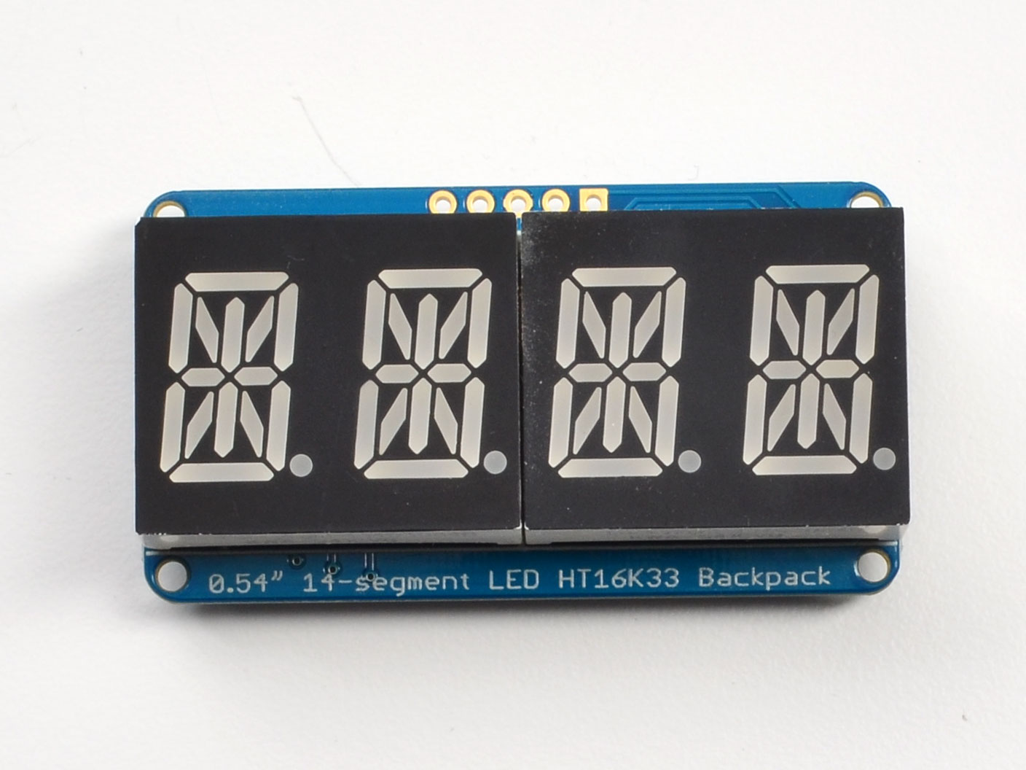
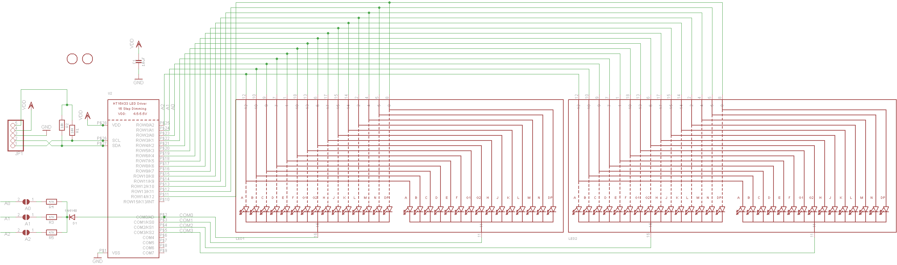
Adafruit LED backpack
14-Segment Display
I2C Communication

Slide 7
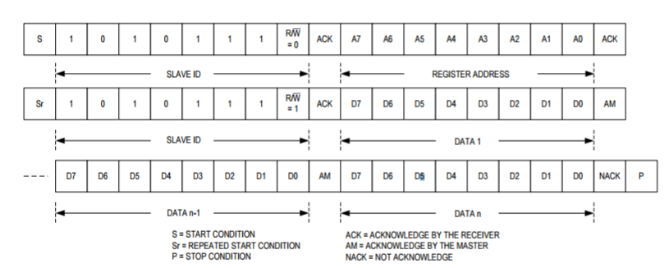
i2C Protocol
SDA SCL
Half Duplex
Can only send or receive one at a time
Communicates via addressing

Slide 8
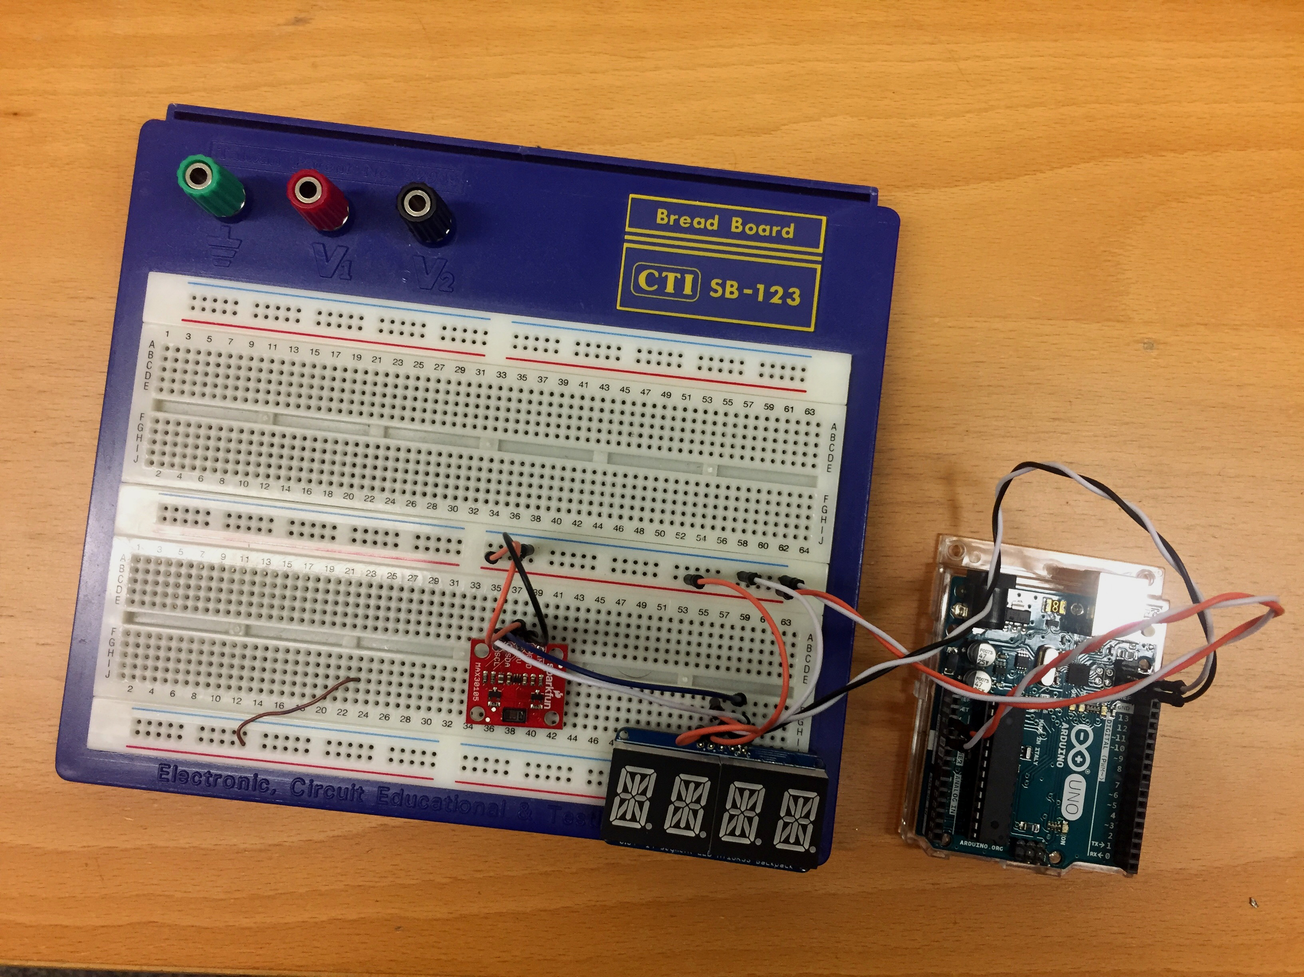




Our Design
Arduino Micro Controller
Adafruit LED Backpack
MAX30105 Particle Sensor
Measures Heart Rate using IR + Sensor
Processes Photodiode data for heart rate
Displays recorded Heart Rate on LED Display
Displays “love” if Heart Rate exceeds 80BPM

Slide 9
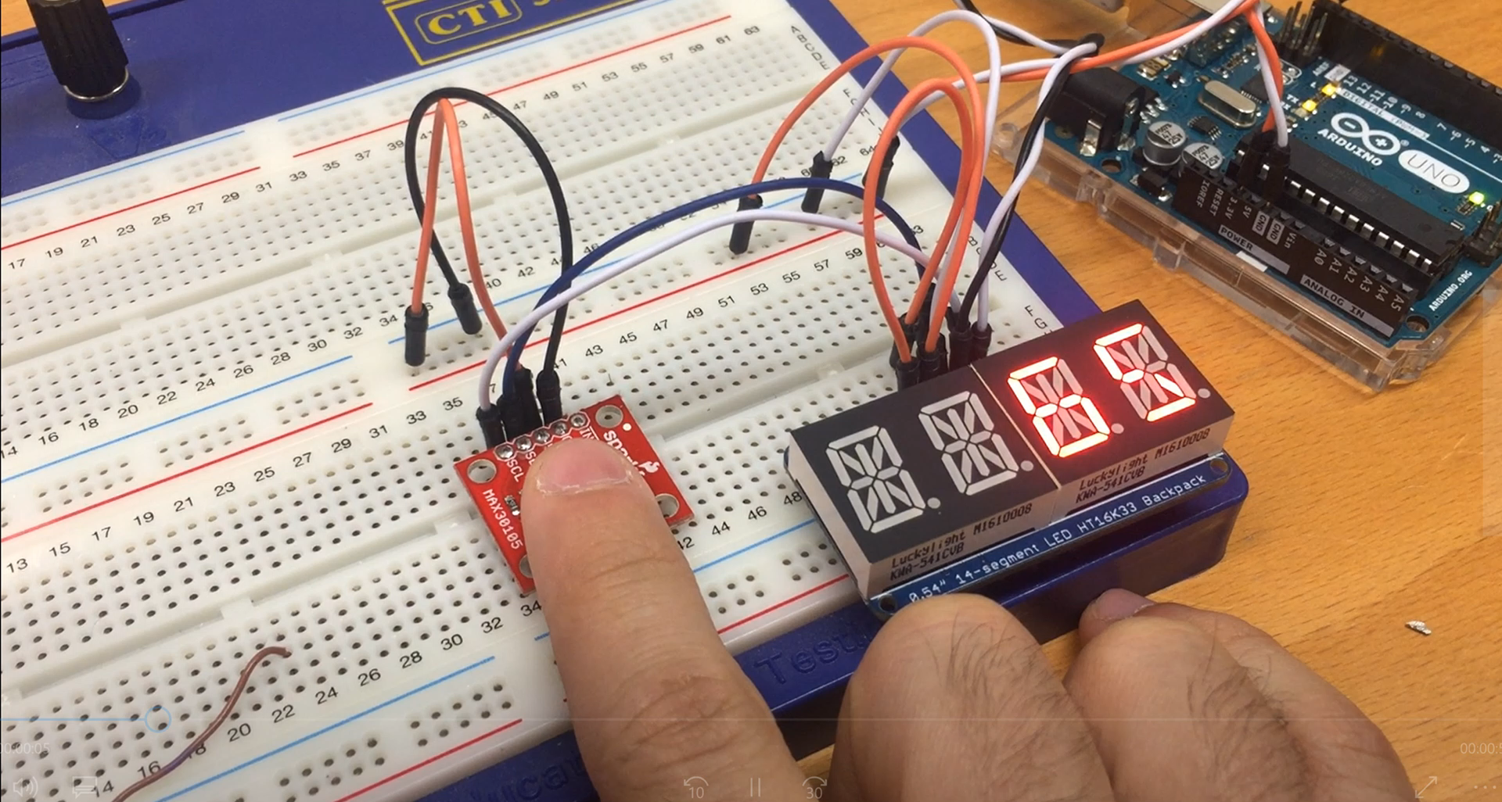
Demo of Heart Rate

Slide 10
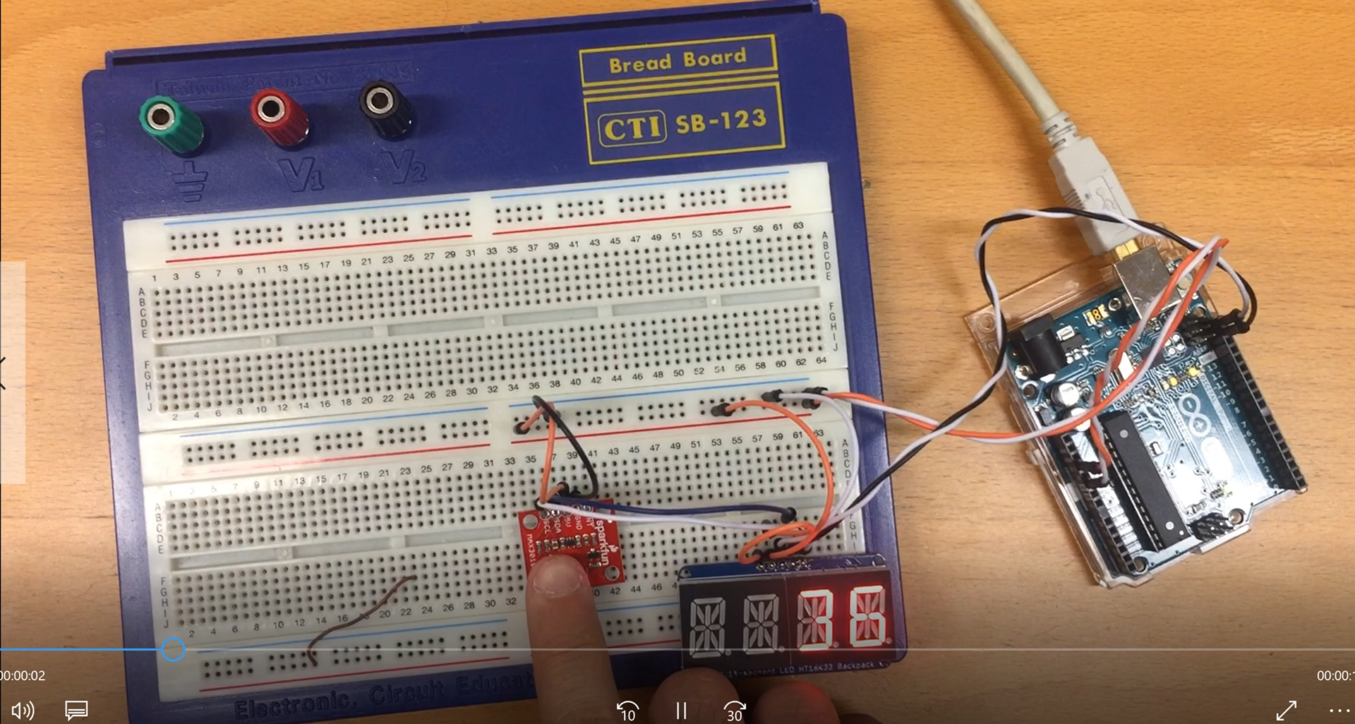
Demo of “Love” Animation

Slide 11
Thank you!

